Slide 1
Technical interview
Jacobo Fernández Vargas

Slide 2
Presentation overlook
Initial data exploration
Feature correlation
Efficiency prediction
Mixing time analysis
Recommendations

Slide 3
Initial Data exploration
An initial look to the data showed that several features had only one value (maybe different options will be added in the future).
All these variables were removed to speed up the calculations as they contain no information.
Several other features were removed as they were considered spurious (values indicating timestamp, or manual interruptions to the process), redundant (variables indicating whether another variable was used or not.). This process leave us with 32 features
Finally other features were removed as they were considered false predictors. These features were removed using ‘common sense’ and making some assumptions. In a real scenario, I would have collected more information about them before removing them. Finally, the categorical data is transformed using a one-hot encouding.

Slide 4
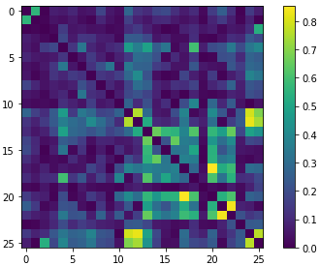
Feature correlation
The correlation matrix across all features was calculated to remove possible redundant features.
Above 80%:
carbonchargingrate (kg/sec) - carbon_black_act_weight
oil_actual_weight - oil_charging_time
Above 70%:
mix_energy - total_weight
processoil_dust_stopinkg - lubeoil_dust_stop inkg
Above 60%:
actual_polymer_weight_3 - actual_polymer_weight_4 carbon_charging_time - carbon_black_act_weight carbon_black_act_weight - oil_charging_time

Slide 5
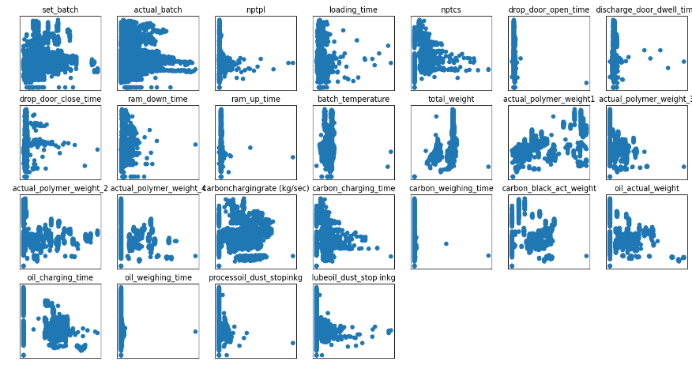
Efficiency Prediciton: Data distribution

Slide 6
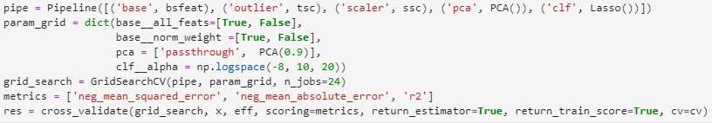
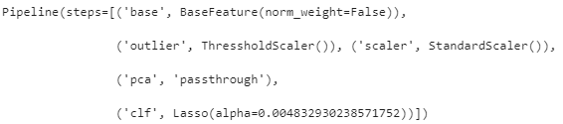
Efficiency prediction: Linear regression
'test_neg_mean_squared_error': -0.356
'train_neg_mean_squared_error': -0.353
test_neg_mean_absolute_error': -0.407
'train_neg_mean_absolute_error': -0.406
'test_r2': 0.635,
train_r2': 0.638

Slide 7

Efficiency Prediction: AdaBoost
'test_neg_mean_squared_error': -0.023 'train_neg_mean_squared_error': -0.012, 'test_neg_mean_absolute_error': -0.086, 'train_neg_mean_absolute_error': -0.072
'test_r2': 0.976
'train_r2': 0.987
Under normal circumstances I would implement at least one or two other complex methods and compare their performance. However, due to time limitations I will skip this point. To compare them, a non-parametric paired Kruskall-Wallis tests could be performed using each of the error predictions for every sample available.

Slide 8
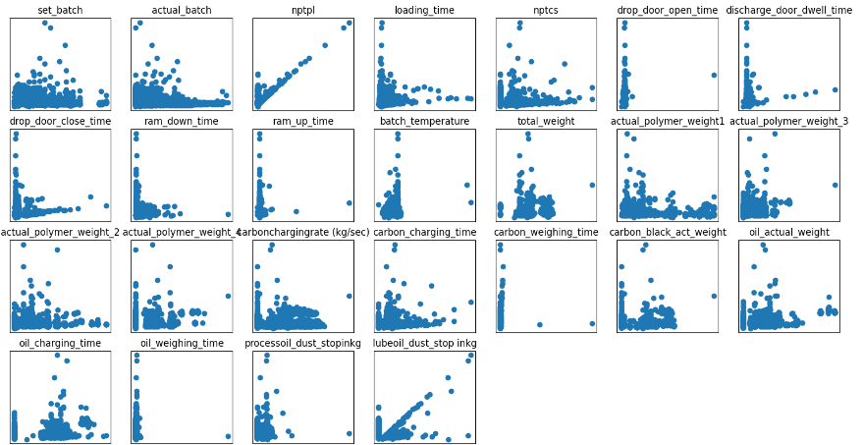
Mixing Time Analysis: Data distribution

Slide 9
Mixing Time Analysis: Linear correlation
We can see that, in general the correlation levels for these features are quite low. The only that has a correlation above 50% (i.e. r^2 > 0.25) is Polymer4 weight. With a positive correlation, indicating that using this polimer increases the time that takes for the process to finish.
Similarly, the carbon black weight seems to have a detrimental effect on the time to complete the task. The only factor that seems to positively influence the time to complete the task is 'set_batch’.
It seems that earlier batches finish faster than later ones, this may indicate a degradation over the batch periods of the machine. However, this correlation is not large.
To analyse whether any of the binary variables have any impact on the time, I will use the Fisher Discriminant Ration (FDR), as it seems appropiate to identify weather using a specific option has an effect or not.

Slide 10
Mixing Time Analysis: Fisher Discriminant Ratio
This analysis shows that are just a few features that make a difference.
It seems that the plant BNB105 is considerably faster than BNB107 (this should be treated carefully as there may be other co-funding factors, further analysis is required).
Then we know also that using recipes SMT361 and XMT3289_H is not recommended as they increase very significantly the time required to finish the process.
We can confirm from the previous analysis, that the use of carbon increases the time needed for the procedure. Also, we can confirm that not using nptcs is beneficial for the time needed for the process (further information about this variable is required).

Slide 11
Recommendations
Further knowledge regarding the problem is needed. All these recommendations should be considered in combination with expert knowledge of the problem.
Further study why BNB105 is faster than BNB107. This could just be because of the recipes used at each of them and may have nothing to do with the factories themselves. However, a deeper analysis may show that one of the factories is more efficient than the other. If so, study why and how the BNB107 can improve.
Reduce use of polymer 4 and, particularly, carbon (do not know if this is feasible)
Further investigate why earlier batches are faster. It could be a degradation over time of the machines, or maybe they are not properly cleaned after each batch.

